Slide 1
CONDITIONAL STATEMENTS AND LOOPS

Slide 2
Review: What is a Boolean?

Slide 3
Workflow Diagrams

Slide 4
CONDITIONAL STATEMENTS
Conditions are expressions that evaluate to a Boolean value
They often involve comparison operators (<, >, ==, !=, <=, >=) and logical operators (and, or, not)
Python relies on indentation (whitespace at the beginning of a line) to define code blocks
Incorrect indentation will lead to errors.
You can create Nested Conditional Statements to control the flow of code

Slide 5
THE "IF" STATEMENT
Executes a block of code only if a given condition evaluates to True
Syntax:
  if condition:
  # code
Example:
  age = 20
  if age >= 18:
  print(“You are eligible to vote.”)

Slide 6
THE “ELSE” STATEMENT
“Else” is used in conjunction with “if”
Provides an alternate block of code to execute if the “if” condition evaluates to false
Syntax:
  if condition:
  # code
  else condition:
  # code
Example:
  temperature = 78
  if temperature > 85:
  print(“It’s hot out today!”)
  else:
  print(“It’s not too hot.”)

Slide 7
THE “ELIF” STATEMENT
“elif” is short for else-if
It allows for checking multiple conditions sequentially
If the “if” condition evaluates to false, the “elif” statements are evaluated in order until one evaluates to True
Syntax:
  if condition:
  # code
  elif condition:
  # code
  else condition:
  # code
Example:
  score = 89
  if score >= 90:
  print(“Grade: A”)
  elif score >= 80:
  print(“Grade: B”)
  elif score >= 70:
  print(“Grade: C”)
  elif score >= 60:
  print(“Grade: D”)
  else:
  print(“Grade: F”)

Slide 8
NESTED CONDITIONAL STATEMENTS
You can place “if” or “if...else” statements inside other “if” or “else” blocks to create more complex decision structures.
Example:
  weather = "rainy“
  temperature = 45
  if weather == "rainy":
  if temperature < 50:
  print("It's cold and rainy. Wear a jacket and bring an umbrella.")
  else:
  print("It's rainy but warm. Just bring an umbrella.")
  else:
  print("No rain today. Enjoy the weather!")
Code Examples

Slide 9
EXERCISE - CONDITIONAL STATEMENTS
5 minutes
Write a function that checks a number and returns “positive,” “zero,” or “negative”
Notes:
Remember:
Defining a function
If-elif-else
Comparison operators
Early exits

Slide 10
Loops!

Slide 11
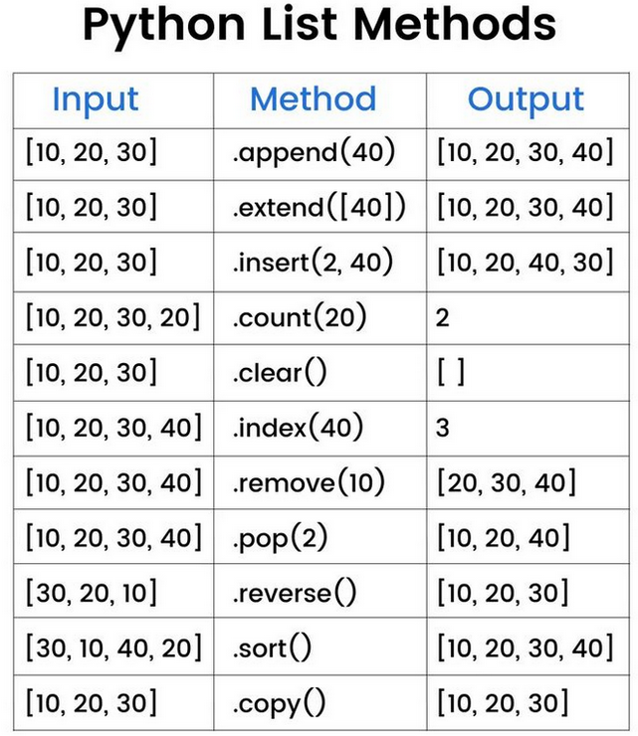
But first, a new datatype!
The humble list
Example:
  my_list = ['hello']
  my_list.append('goodbye')
  my_list.append(5)
  my_list.append(True)
  my_list
  ['hello', 'goodbye', 5, True]
  len(my_list)
  4

Slide 12
LOOPS
Fundamental control flow structures used to execute a block of code repeatedly
Two primary types of loops are “for” and “while” loops, which have distinct purposes
You can nest loops

Slide 13
RANGE() FUNCTION
A built-in Python function
Output is a “range object,” which is an immutable sequence type and memory efficient compared to a list
range(stop)
  Generates a sequence of numbers starting from 0 (default) up to, but not including, the stop value
  The numbers increment by 1 (default)
  Example: range(5) generates 0, 1, 2, 3, 4
range(start, stop)
  Generates a sequence of numbers starting from the start value (inclusive) up to, but not including, the stop value
  The numbers increment by 1 (default)
  Example: range(2, 7) generates 2, 3, 4, 5, 6
range(start, stop, step)
  Generates a sequence of numbers starting from the start value (inclusive) up to, but not including, the stop value
  The numbers increment or decrement by the step value (integer!)
  If step is positive, it increments. If step is negative, it decrements (for counting backwards).
  step cannot be 0, as it would lead to an infinite loop and raise a ValueError
  Example: range(1, 10, 2) generates 1, 3, 5, 7, 9
  Example: range(5, 0, -1) generates 5, 4, 3, 2, 1

Slide 14
“FOR” LOOP
For loops iterate over a sequence, such as a list, tuple, string, or range, or other iterable objects
A block of code is executed once for each item in the sequence
Syntax:
  for variable in sequence:
  # code
Example:
  fruits = ["apple", "banana", "cherry"]
  for fruit in fruits:
  print(fruit)

Slide 15
“WHILE” LOOP
While loops execute a block of statements repeatedly as long as a given condition is True
The loop continues to execute until the condition becomes false
Forever loops
Syntax:
  while condition:
  # block of code
Example:
  count = 0
  while count < 5:
  print(count)
  count += 1

Slide 16
Hands-On #1

Slide 17
More Loops

Slide 18
LOOP CONTROL STATEMENTS
break
  terminates the current loop immediately, execution resumes at the statement following the loop
continue
  skips the rest of the current iteration of the loop and proceeds to the next iteration
pass
  null operation, used as a placeholder in loops or other code blocks where a statement is syntactically required but there is nothing to execute

Slide 19
NESTED LOOPS
Python allows loops inside other loops, called nested loops
The inner loop executes completely for each iteration of the outer loop
Example:
  for i in range(3):
  for j in range(2):
  print(i, j)

Slide 20
Hands-On #2

Slide 21
Questions?

